Slide 1
Busy Bee ideas
Loren Rieffer-Champlin

Slide 2

Old Ideas (6/1)

Slide 3
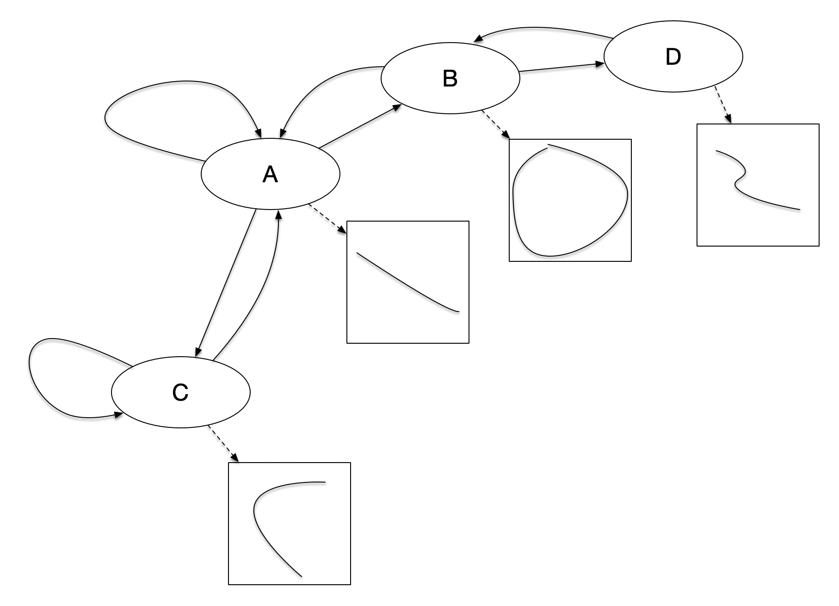
Finite-State Machine
x_7
x_5
x_6
x_4
x_3
x_1
x_0
x_2
Path Plan given state

Slide 4
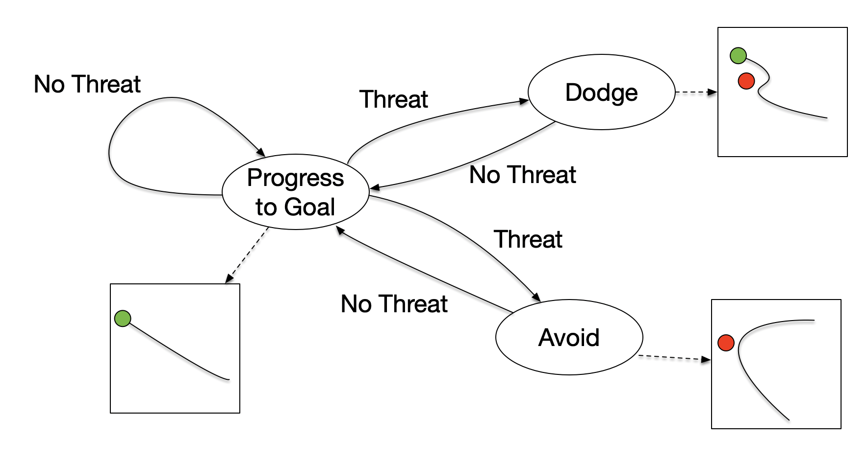
EXAMPLE

Slide 5
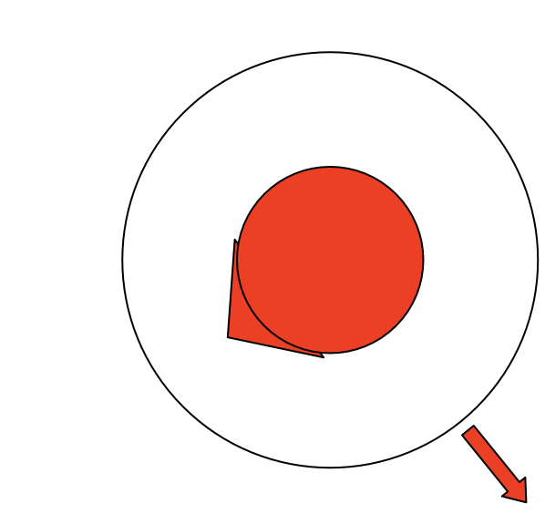
Repulsion Field
Wasp
We seem to assume,
Facing

Slide 6
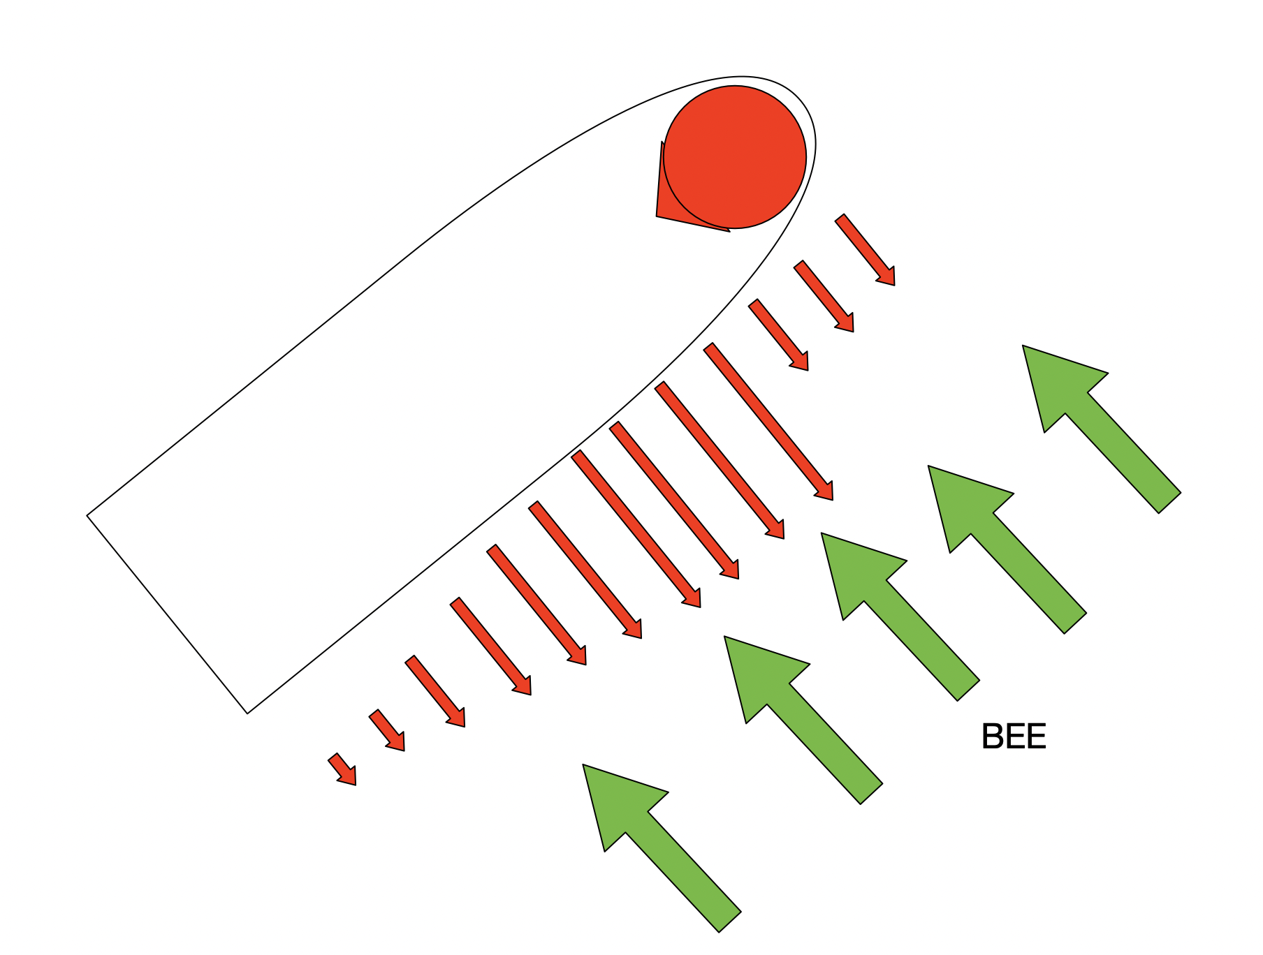
Repulsion Field
But maybe more like,

Slide 7
Research Questions
Can we build an accurate symbolic model of the human’s behavior?
Can we use the symbolic model to evaluate the discrepancy between the human’s behavior and the intended behavior of the AI?

Slide 8
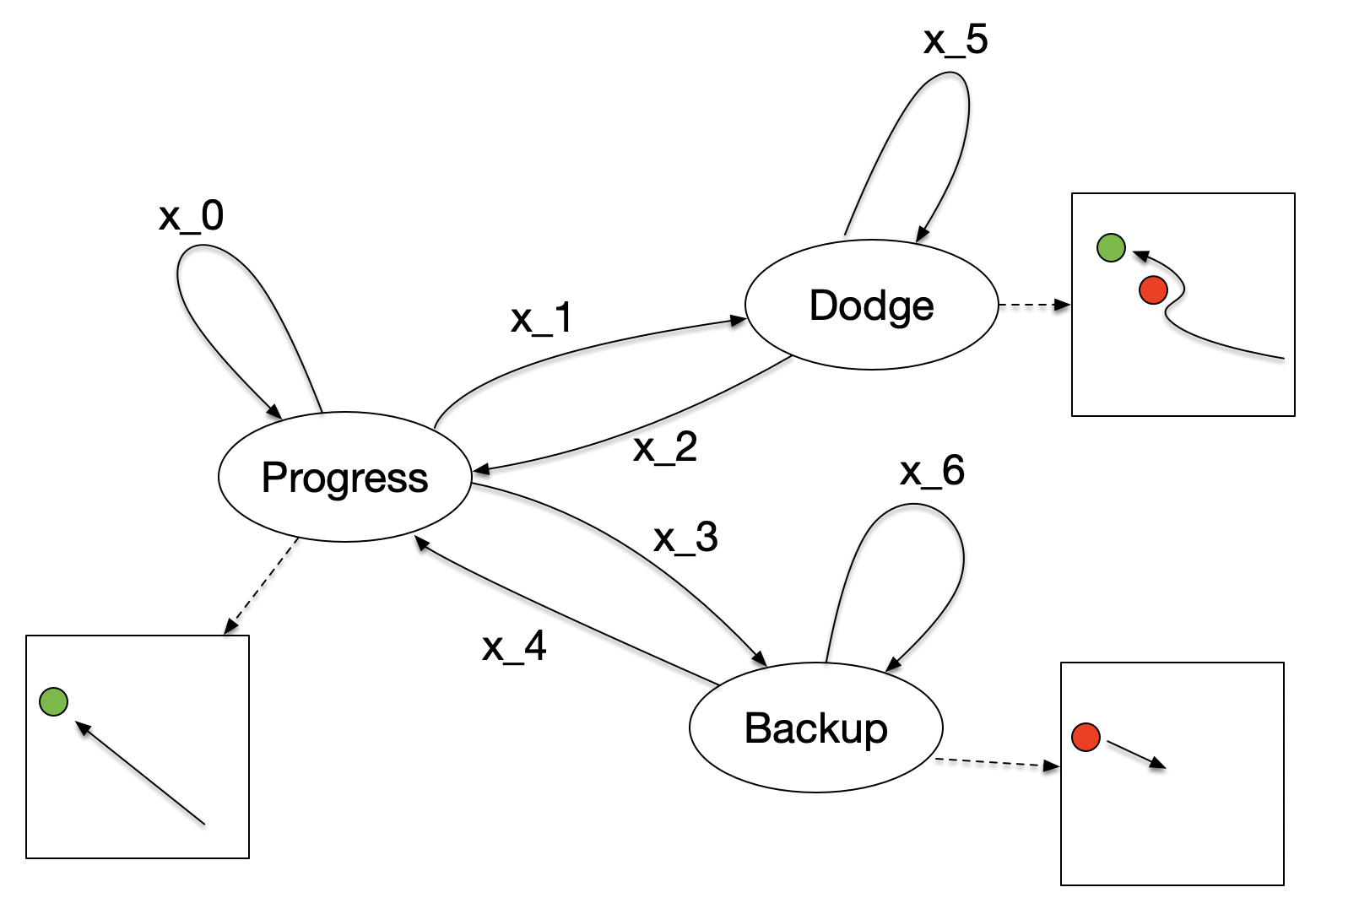
Symbolic model

Slide 9
Repulsion field
Consider the velocity of the obstacles in the repulsive field by creating virtual copies of the obstacles that simulate a human estimate of where an obstacle will be when the bee intersects its path.

Slide 10
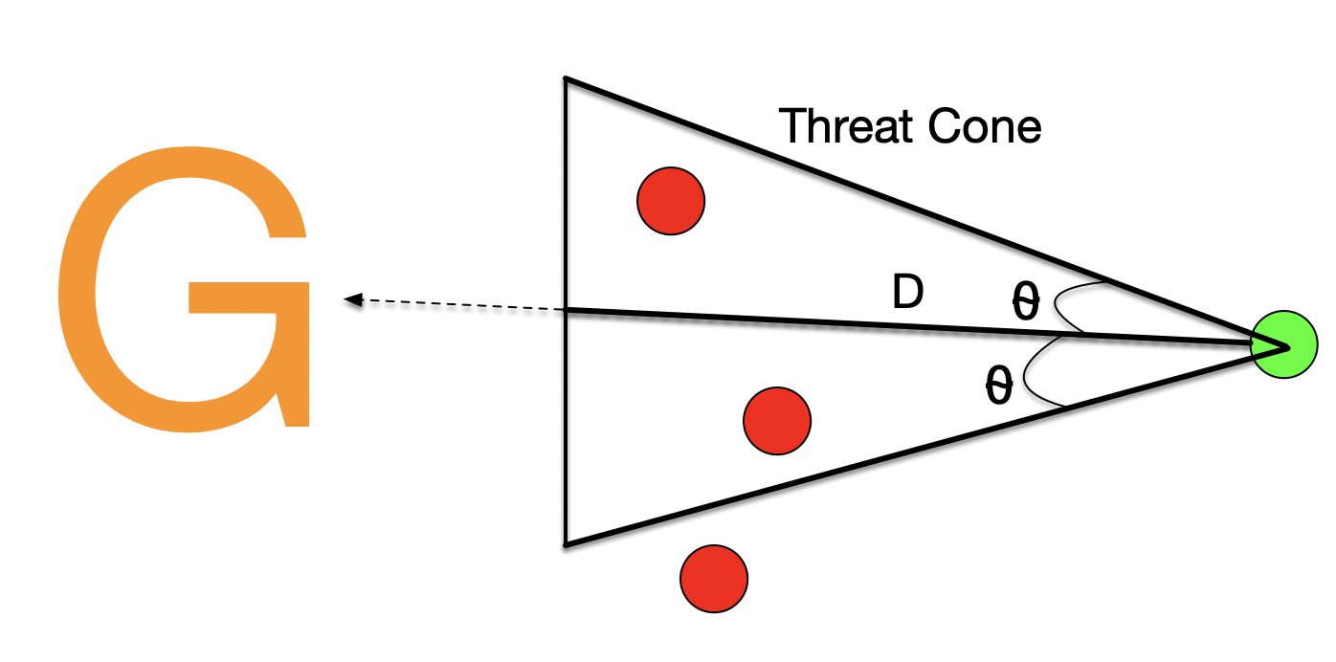
Triggers for state transitions.
Progress -> Dodge:

Slide 11
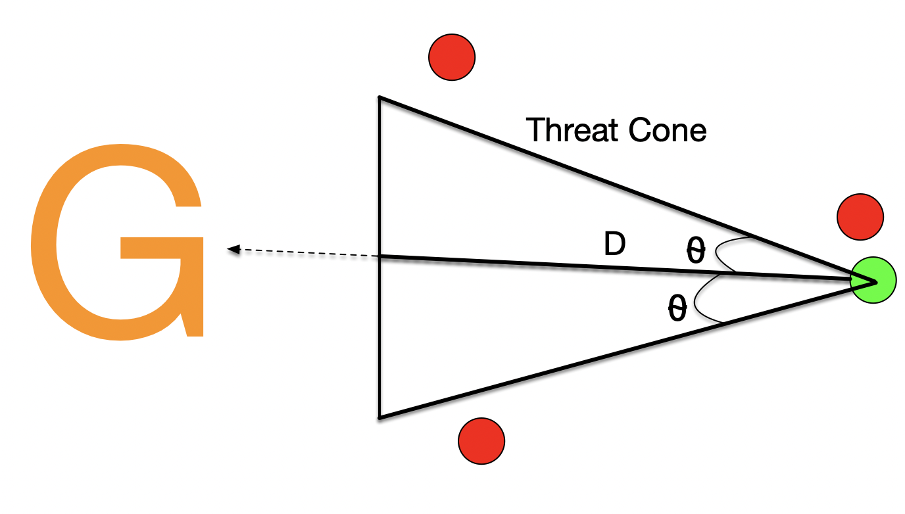
Triggers for state transitions.
Progress -> Progress:

Slide 12
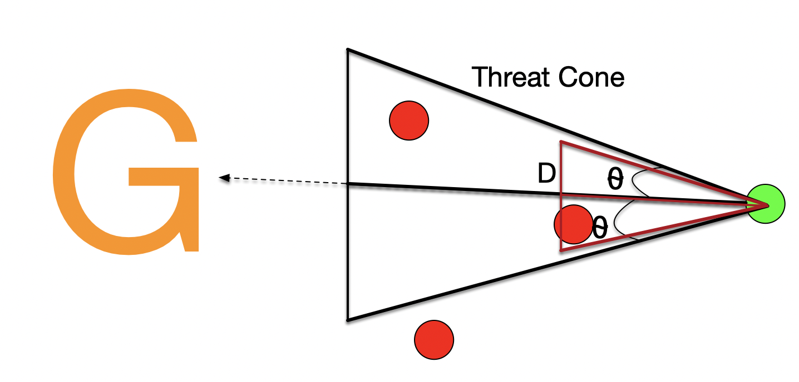
Triggers for state transitions.
Progress -> Backup:

Slide 13
Obstacle Trajectory Predictions
Research Question: How does experience affect obstacle trajectory predictions?

Slide 14

New Ideas (8/20)

Slide 15
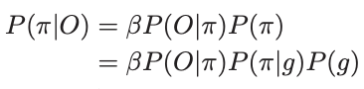
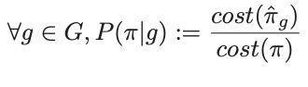
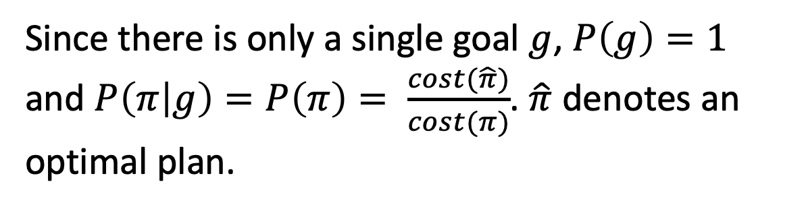
Likelihood of path
From Kaminka, Vered, and Agmon (2018),
Since there is only a single goal $g$, $P\left(g\right)=1$ and $P\left(π | g\right)=P\left(π\right)= \frac{cost(\hat{π})}{cost(π)}$. $\hat{π}$ denotes an optimal plan.

Slide 16
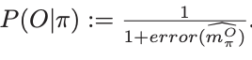
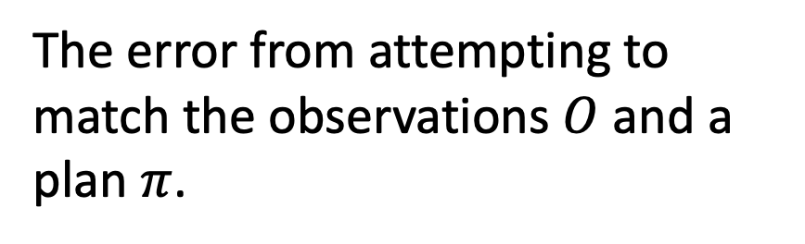
Likelihood of path
From Kaminka, Vered, and Agmon (2018),
The error from attempting to match the observations $O$ and a plan $π$.

Slide 17
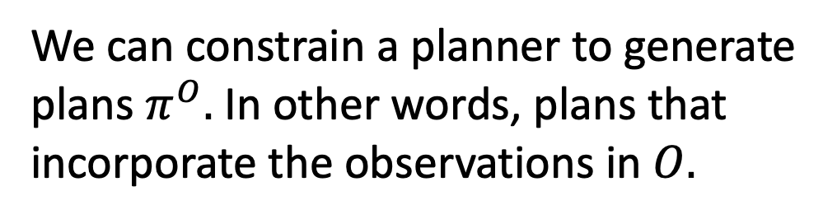
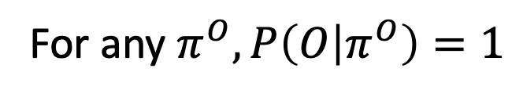
Likelihood of path
From Kaminka, Vered, and Agmon (2018),
We can constrain a planner to generate plans $π^{O}.$ In other words, plans that incorporate the observations in $O.$
For any $π^{O}, P\left(O | π^{O}\right)=1$

Slide 18
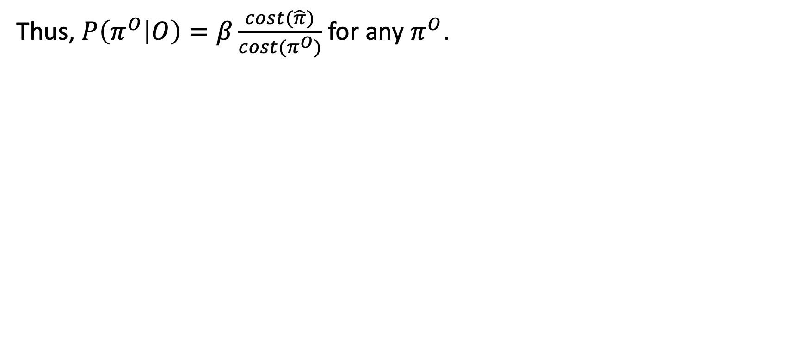
Likelihood of path
Thus, $P\left(π^{O} | O\right)=β\frac{cost(\hat{π})}{cost(π^{O})}$ for any $π^{O}$.

Slide 19
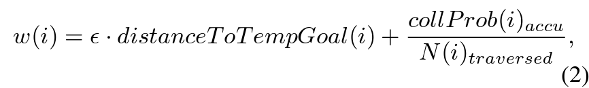
SES cost function
This is computed for each path
SES/RRT picks the path that minimizes w.
They call it “greed”, but it can also be somewhat re-interpreted as risk tolerance. The greater it is, the more willing I am to risk collision to reduce my distance from the goal.

Slide 20
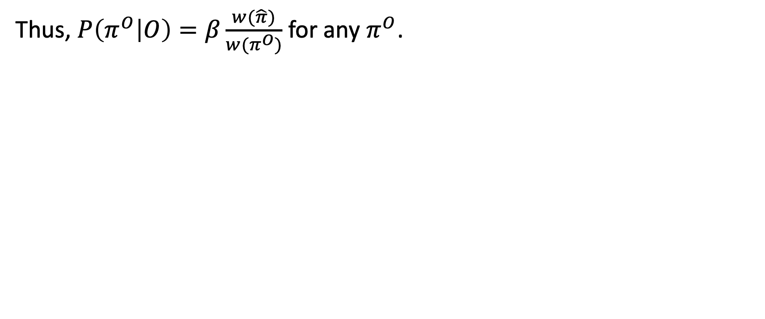
SES cost function
Thus, $P\left(π^{O} | O\right)=β\frac{w(\hat{π})}{w(π^{O})}$ for any $π^{O}$.

Slide 21
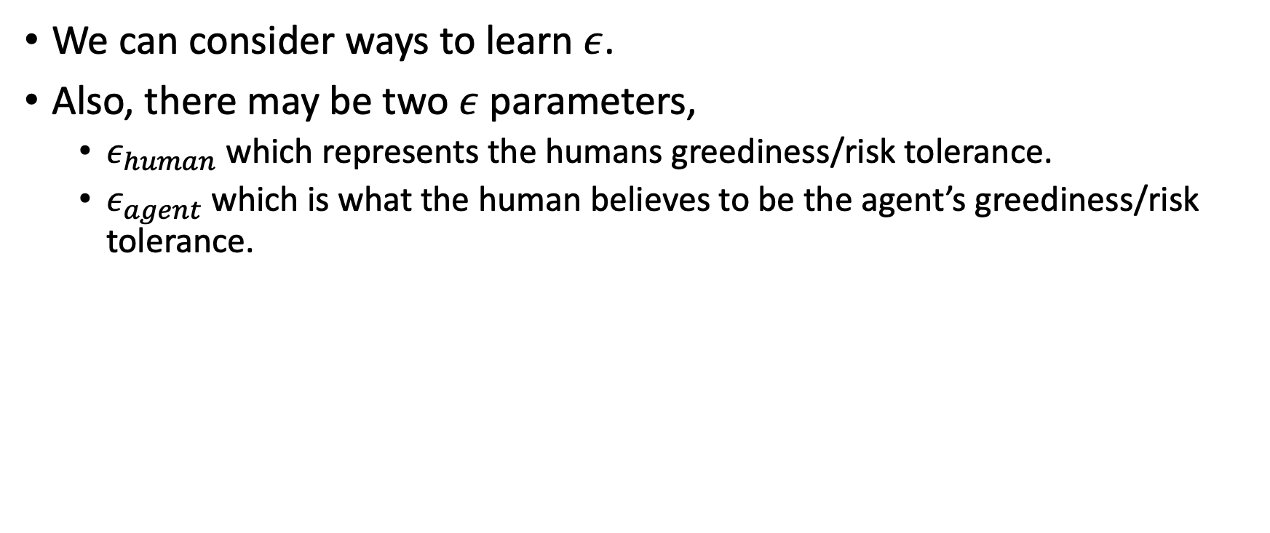
Inference
We can consider ways to learn $ε$.
Also, there may be two $ε$ parameters,
$ε_{human}$ which represents the humans greediness/risk tolerance.
$ε_{agent}$ which is what the human believes to be the agent’s greediness/risk tolerance.

Slide 22
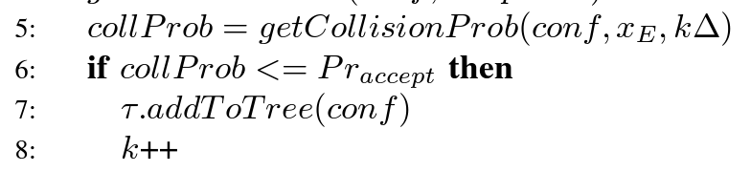
Modifications to SES
RRT (at least this version) only accepts paths under a fixed probability
This is for pruning out paths that are likely to lead to collisions

Slide 23
Modifications to SES
I removed this since we might accidently prune out paths that match the true data.
Our planner is not meant to find an optimal path, but to mimic possible paths that the human-agent team will take. Praccept is also another parameter that needs to be tuned.

Slide 24
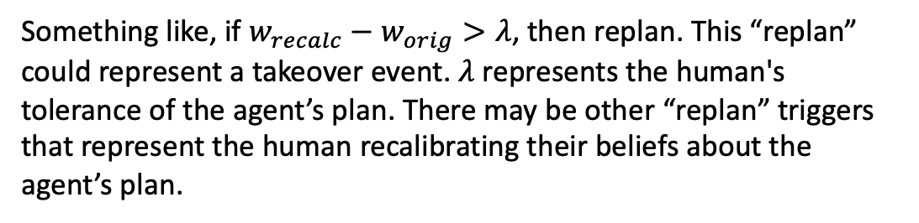
SES replanning
Current SES uses Praccept (among other conditions) to trigger replanning. I instead want to formulate a new condition that involves the above equation.
Something like, if $w_{recalc}−w_{orig}>λ$, then replan. This “replan” could represent a takeover event. $λ$ represents the human's tolerance of the agent’s plan. There may be other “replan” triggers that represent the human recalibrating their beliefs about the agent’s plan.

Slide 25
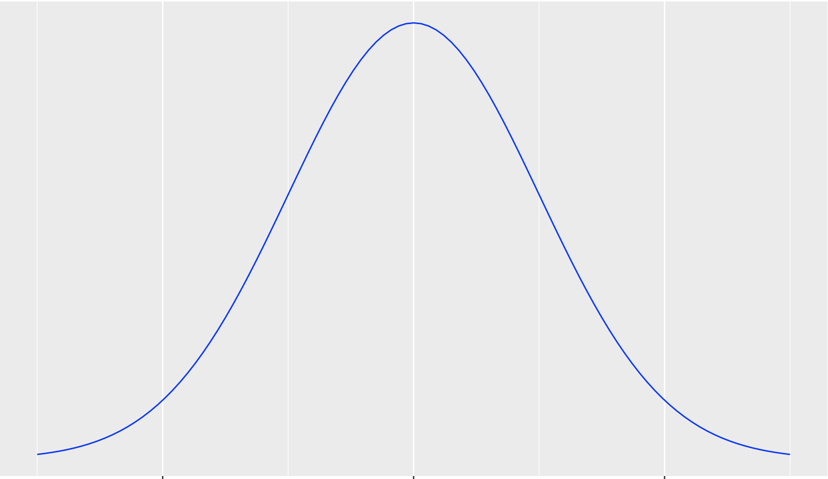

Collision probabilities
Occupancy Distribution
$$μ$$
The mean distance traveled per some time step t.

Slide 26
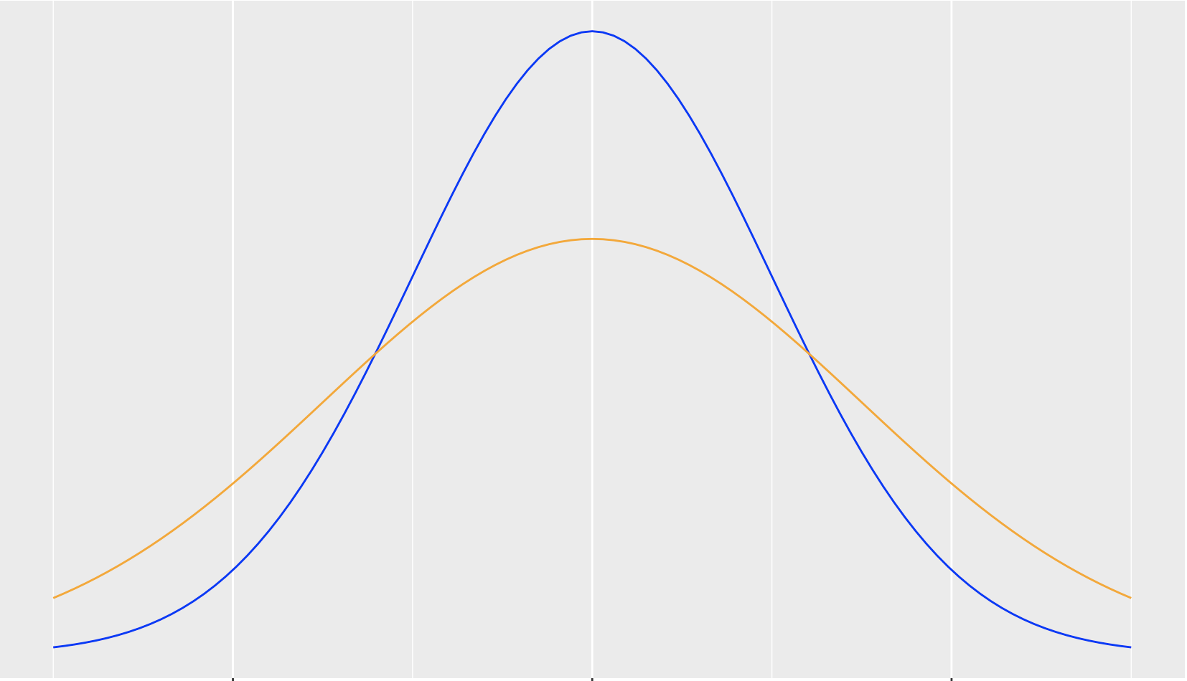

Human perception of collision probabilities
True Occupancy Distribution
Perceived Occupancy Distribution
$$μ$$

Slide 27
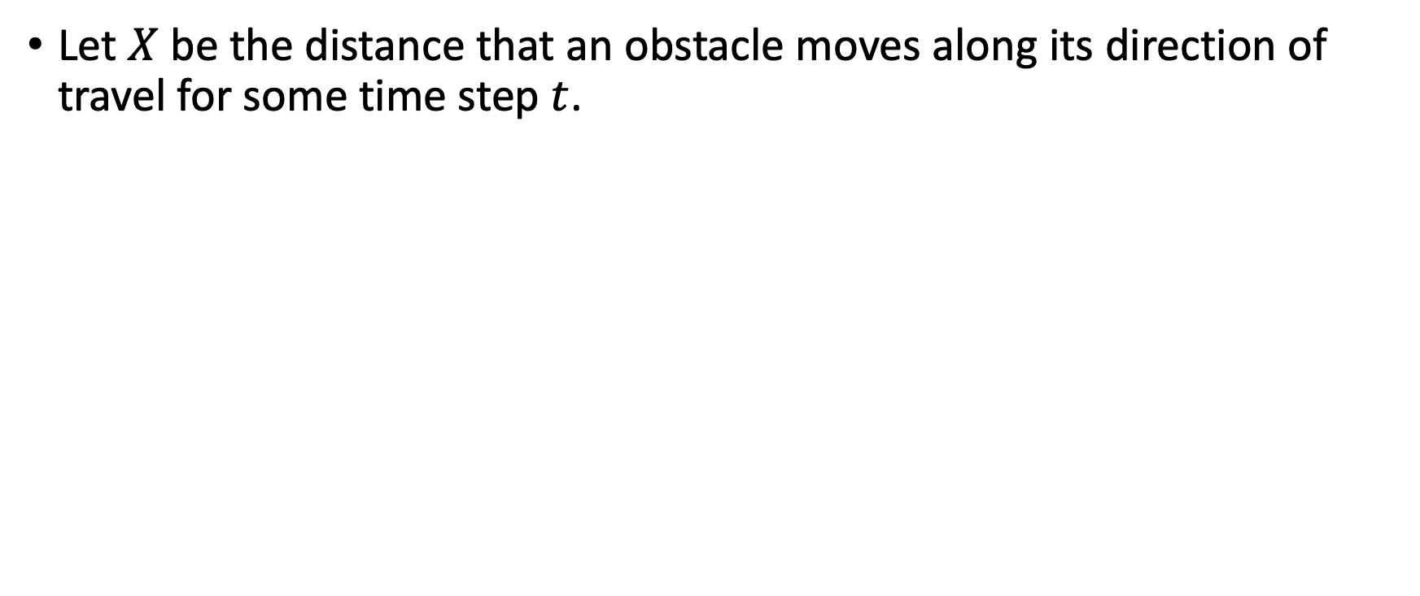
Human perception of collision probabilities
Let $X$ be the distance that an obstacle moves along its direction of travel for some time step $t$.

Slide 28
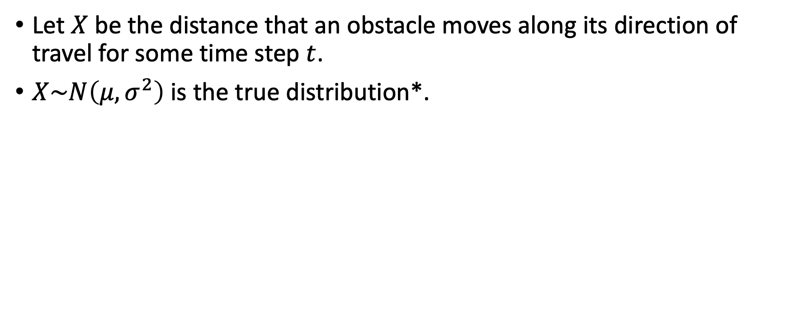
Human perception of collision probabilities
Let $X$ be the distance that an obstacle moves along its direction of travel for some time step $t$.
$X\sim N\left(μ,σ^{2}\right)$ is the true distribution*.
*It’s technically a truncated normal bound between the min and max distances the obstacle can travel

Slide 29
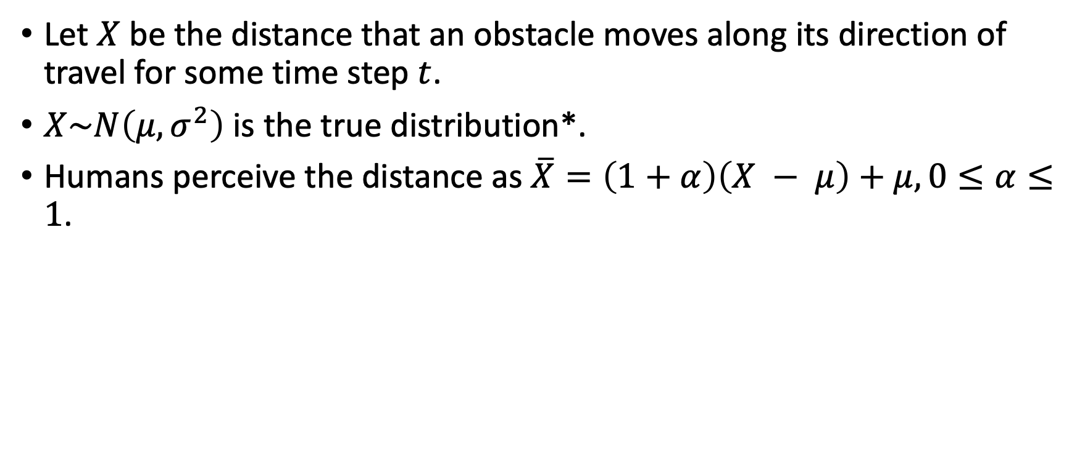
Human perception of collision probabilities
Let $X$ be the distance that an obstacle moves along its direction of travel for some time step $t$.
$X\sim N\left(μ,σ^{2}\right)$ is the true distribution*.
Humans perceive the distance as $\overline{X}=\left(1+α\right)\left(X − μ\right)+μ, 0≤α≤1$.
*It’s technically a truncated normal bound between the min and max distances the obstacle can travel

Slide 30
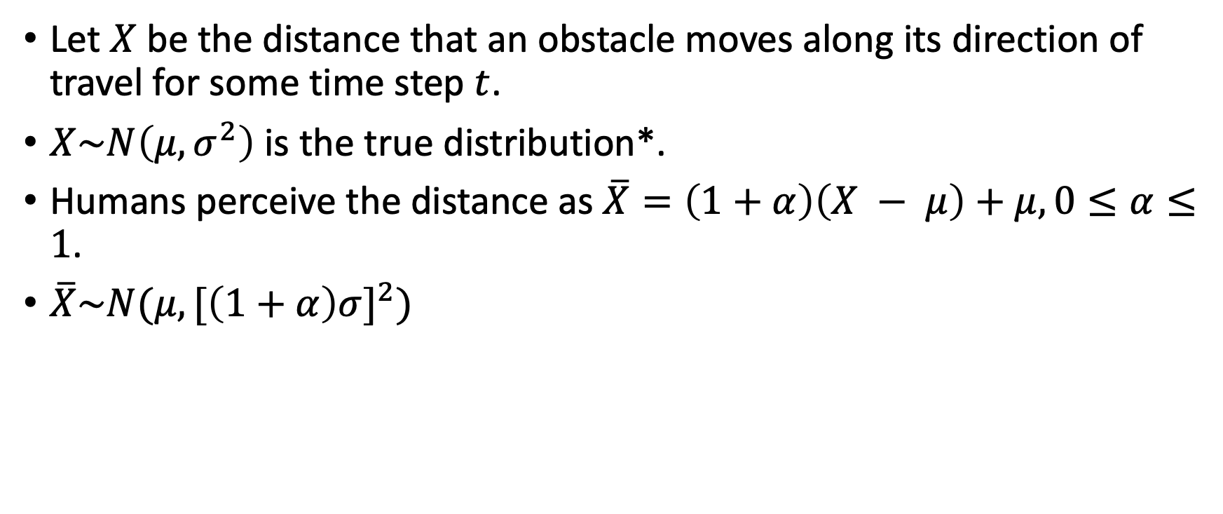
Human perception of collision probabilities
Let $X$ be the distance that an obstacle moves along its direction of travel for some time step $t$.
$X\sim N\left(μ,σ^{2}\right)$ is the true distribution*.
Humans perceive the distance as $\overline{X}=\left(1+α\right)\left(X − μ\right)+μ, 0≤α≤1$.
$\overline{X}\sim N(μ,{[\left(1+α\right)σ]}^{2})$
*It’s technically a truncated normal bound between the min and max distances the obstacle can travel

Slide 31
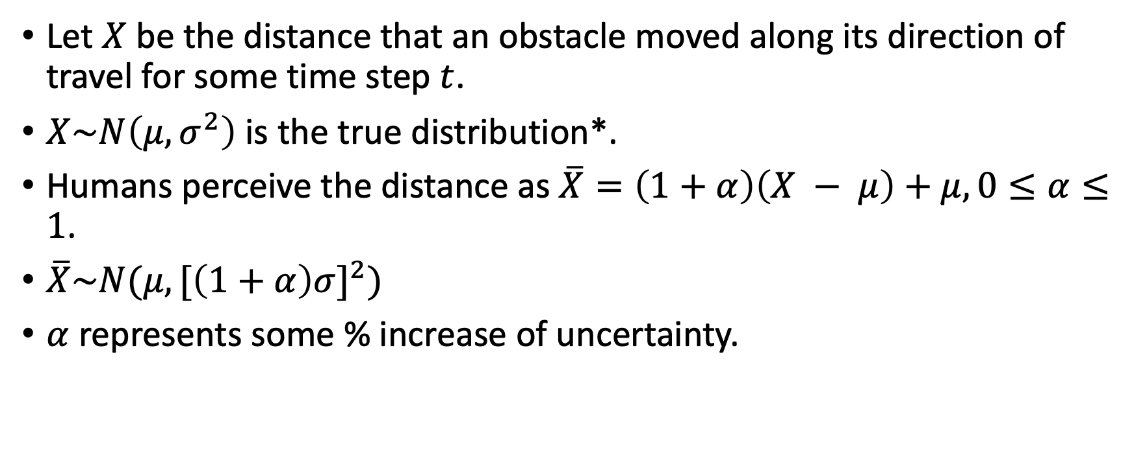
Human perception of collision probabilities
Let $X$ be the distance that an obstacle moved along its direction of travel for some time step $t$.
$X\sim N\left(μ,σ^{2}\right)$ is the true distribution*.
Humans perceive the distance as $\overline{X}=\left(1+α\right)\left(X − μ\right)+μ, 0≤α≤1$.
$\overline{X}\sim N(μ,{[\left(1+α\right)σ]}^{2})$
$α$ represents some % increase of uncertainty.
*It’s technically a truncated normal bound between the min and max distances the obstacle can travel

